Slide 1
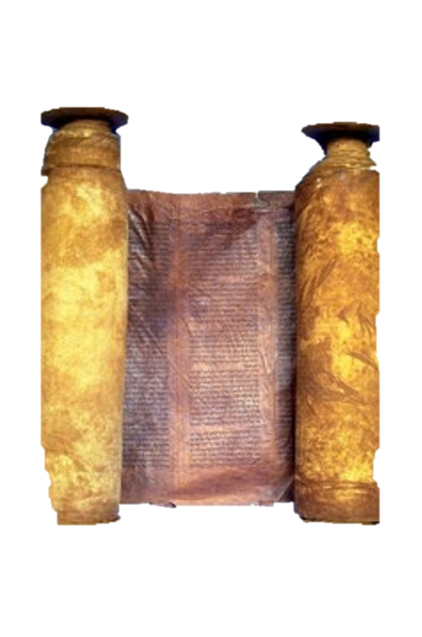
A free CD of this message will be available immediately following the service
2 Kings
20-22
A podcast will also be available later this week at calvaryokc.com

Slide 2
Same year as Sennacherib’s seige
2 kings 20-22

Slide 3
2 kings 20-22

Slide 4
Herod’s Temple
Hezekiah’s Tunnel
Gihon Spring
Pool of Siloam
Over 1750’
2 kings 20-22

Slide 5
2 kings 20-22

Slide 6
Israel
Judah
Hezekiah, 715-686
Manasseh, 686-642
2 kings 20-22

Slide 7
Manasseh ~ causing to forget
2 kings 20-22

Slide 8
2 kings 20-22

Slide 9
2 Chron. 33:10-13 ~ ¹⁰ And the Lord spoke to Manasseh and his people, but they would not listen. ¹¹ Therefore the Lord brought upon them the captains of the army of the king of Assyria, who took Manasseh with hooks, bound him with bronze fetters, and carried him off to Babylon. ¹² Now when he was in affliction, he
2 kings 20-22

Slide 10
implored the Lord his God, and humbled himself greatly before the God of his fathers, ¹³ and prayed to Him; and He received his entreaty, heard his supplication, and brought him back to Jerusalem into his kingdom. Then Manasseh knew that the Lord was God.
2 kings 20-22

Slide 11
2 kings 20-22

Slide 12
Israel
Judah
Manasseh, 686-642
Amon, 642-640
2 kings 20-22

Slide 13
2 kings 20-22

Slide 14
Israel
Judah
Manasseh, 686-642
Amon, 642-640
Josiah, 640-629
2 kings 20-22

Slide 15
2 kings 20-22

Slide 16
Amos 8:11 ~ Behold, the days are coming," says the Lord God,
"That I will send a famine on the land,
Not a famine of bread,
Nor a thirst for water,
But of hearing the words of the Lord.”
2 kings 20-22

Slide 17
2 kings 20-22

Slide 18
Hilkiah ~ Yahweh is my portion
Achbor ~ mouse
Shaphan ~ rock badger
Huldah ~ weasel
2 kings 20-22

Slide 19
2 kings 20-22

Slide 20
Second Quarter ~ KJV, college – mishneh (second or double)
2 kings 20-22

Slide 21
2 kings 20-22

Slide 22
Faithfulness
“Keep about your work that GOD has given you. Do not flinch because the lion roars; do not stop to stone the devil's dogs; do not fool away your time chasing the devil's rabbits. Do your work. Let liars lie, let corporations resolve, let the devil do his worst; but see to it that nothing
2 kings 20-22

Slide 23
Faithfulness
hinders you from fulfilling the work that GOD has given you.
“He has not commanded you to get rich. He has never bidden you defended you character. He has not set you at work to contradict falsehood about yourself which Satan and his servants may start to peddle.
2 kings 20-22

Slide 24
Faithfulness
If you do those things, you will do nothing else; you will be at work for yourself and not for the LORD.
“Keep at your work. Let your aim be as steady as a star. You may be assaulted, wronged, insulted, slandered, wounded and rejected of men. But see to it with steadfast
2 kings 20-22

Slide 25
Faithfulness
determination, with unfaltering zeal, that you pursue the great purpose of your life and object of your being until at last you can say, ‘I have finished the work which Thou gavest me to do.’” - Anonymous
2 kings 20-22

Slide 26
2 kings 20-22

